Slide 1
Multipage Responsive website
Presented By
J.Vineela
ECE

Slide 2
Contents
Introduction
Objectives
Introduction to responsive website
Project Overview
Technologies Used
Challenges and Solutions
Impact and Future Scope
Project Screenshots
Conclusion

Slide 3
Introduction to Education
Education is the cornerstone of personal and societal growth.
Through education, individuals are empowered to think critically, solve problems, and innovate.
Education is not limited to formal schooling; it encompasses lifelong learning.
EduConnect aims to bridge the gap between learners and educators by providing a platform that facilitates easy access to educational resources and expert guidance.
EduConnect offers interactive and engaging learning experiences that cater to diverse learning styles and needs.

Slide 4
Objectives
EduConnect is a multipage responsive website designed to facilitate the connection between educators and learners.
The platform aims to enhance the educational experience by providing easy access to resources, expert guidance, and interactive learning tools.
Create a user-friendly and visually appearing website.
Ensure seamless navigation and accessibility across all devices
Provide valuable educational content and interactive features.

Slide 5
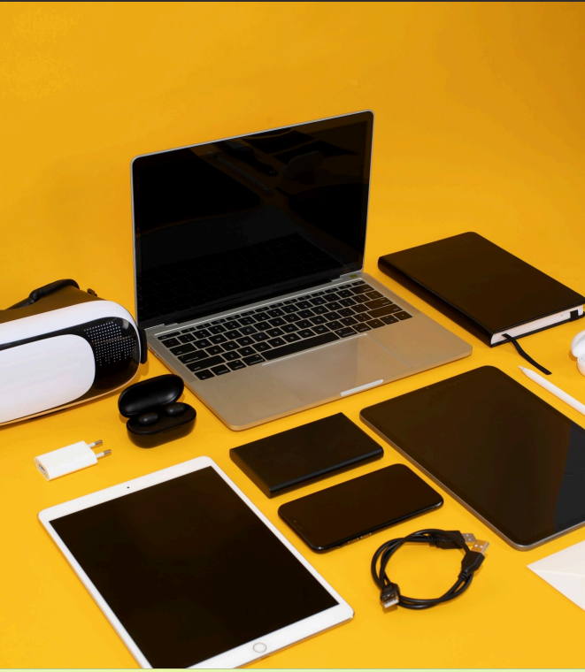
Introduction to responsive Website
In todays digital landscape,responsive design is crucial for creating websites that provide a seamless experience across devices.
This presentation will explore how to effectively build multipage websites using HTML, CSS, and JavaScript to ensure they are both functional and visually appealing.

Slide 6

HTML forms the backbone of any website. It provides the structure and semantic meaning of content. Properly organizing your HTML with elements like headings, paragraphs, and links is essential for creating a responsive layout that is easy to navigate.

Slide 7

CSS for Styling
Css is key for styling websites
Use media queries to apply different styles based on device characteristics.
This ensures your website looks great on all screen sizes, enhancing user experience and engagement.

Slide 8

JavaScript adds interactivity to your website, making it dynamic and engaging. Utilize event listeners and DOM manipulation to enhance user experience. This allows for features like form validation, animations, and content updates without reloading the page.

Slide 9
Project Overview
.
Home page
Overview of Educonnect’s mission and services
Quick navigation to other services.
About page
Information about Educonnect ,its goals and the team
Emphasis on the importance of integrating education and web technology.
Blog Page
Articles ,tutorials and news related to education and technology.
Keeps users updated with the latest trends and insights.

Slide 10
.
Courses page
Catalog of available courses with detailed descriptions
Information on prerequisites and enrollment
Contact Page
Contact form,
email address,
and social media links for user inquiries.

Slide 11

The user-friendly interface of EduConnect ensures that all users can navigate the platform with ease. With clearly defined sections and intuitive design, users can quickly find the resources they need, enhancing their overall experience and satisfaction.

Slide 12
Technologies Used
HTML for structure
Css for styling
Javascript for interactivity
Responsive design principles.

Slide 13

Challenges and solutions
Ensuring responsiveness:
Media queries, flexible layouts.
Creating a user-friendly interface:
Simple navigation, clear layout.
Integrating interactive elements:
JavaScript for dynamic features.

Slide 14
Impact and future enhancements
Impact
Enhanced Accessibility
Improved Engagement
Community Building
Future enhancement
Course Expansion
Advanced Features
Tech Integration:

Slide 15
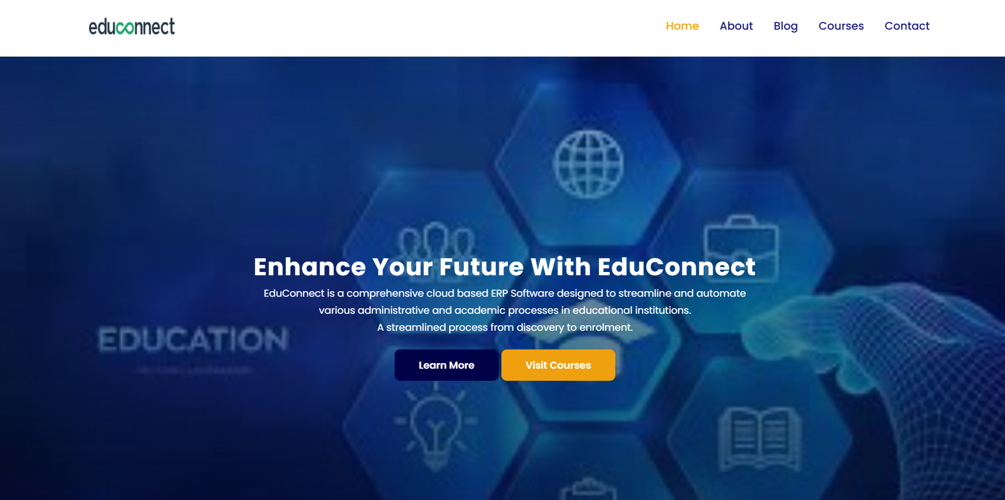



Project screenshots

Slide 16

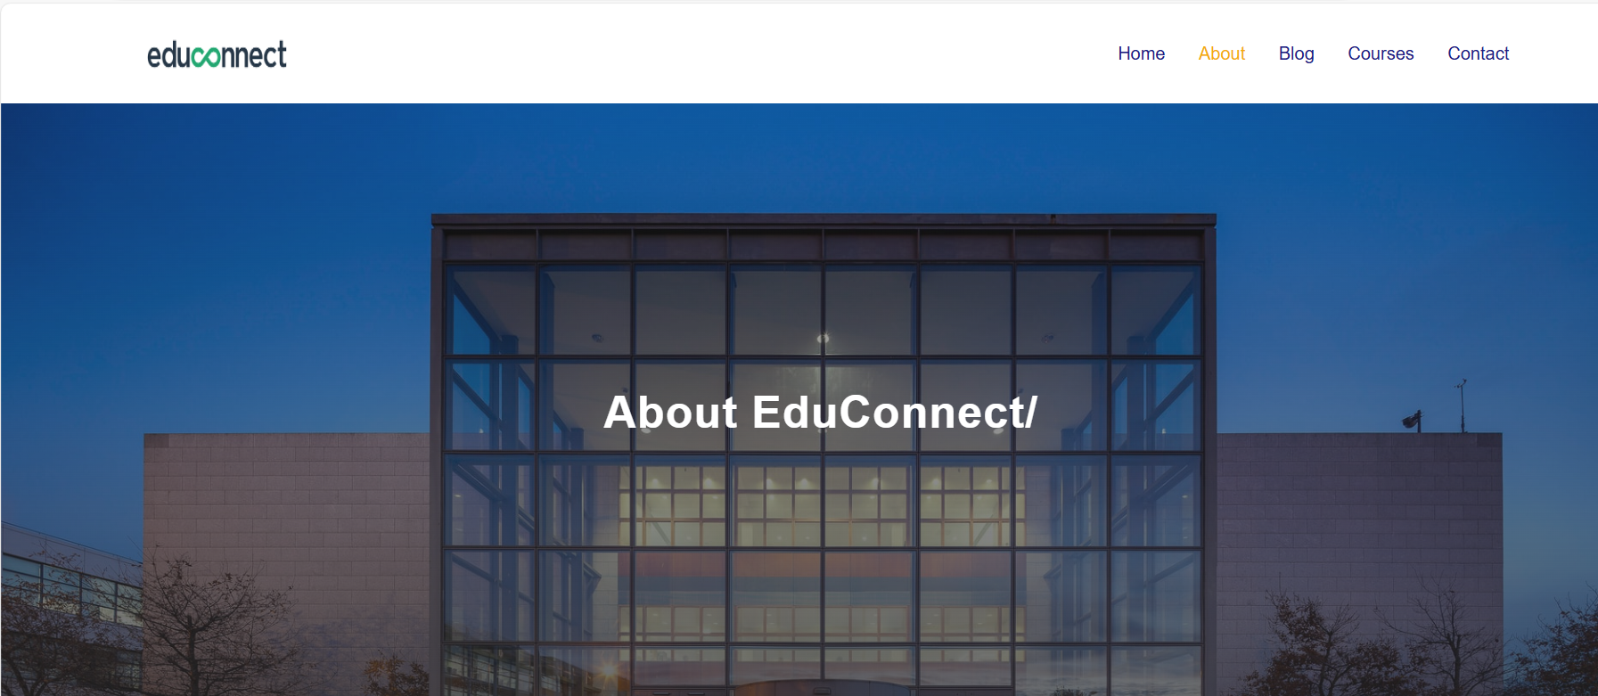
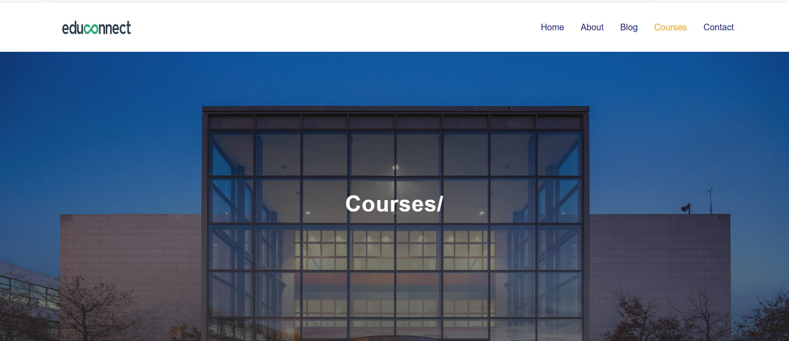
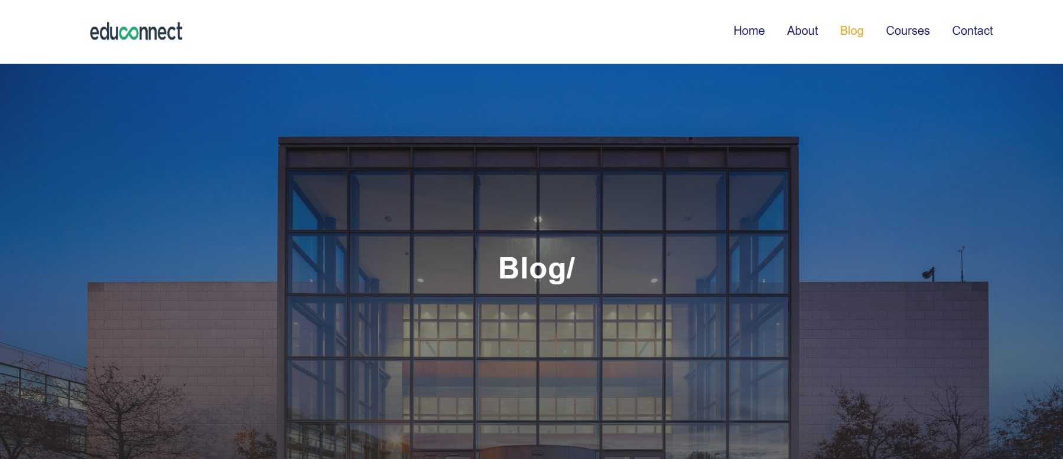
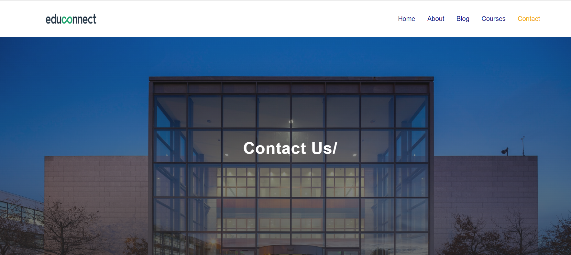

Slide 17

Conclusion
In conclusion ,Educonnect is transforming the educational landscape by providing a comprehensive, engaging, and accessible platform for all users. Its features promote collaboration, enhance learning, and build strong educational communities, paving the way for a brighter future.

Slide 18


